Slide 1
Getting started with musicfirst software
-Jason Weier
Director of Bands Beechcroft high school

Slide 2
Logging in as a teacher
Go to ccsohmusic.musicfirstclassroom.com
Your username is First.Last ie: Jason.Weier (if you have two last names as in Salgado-Hernandez it is First.LastLast ie: Joseph.SalgadoHernandez
Your initial password is Music

Slide 3
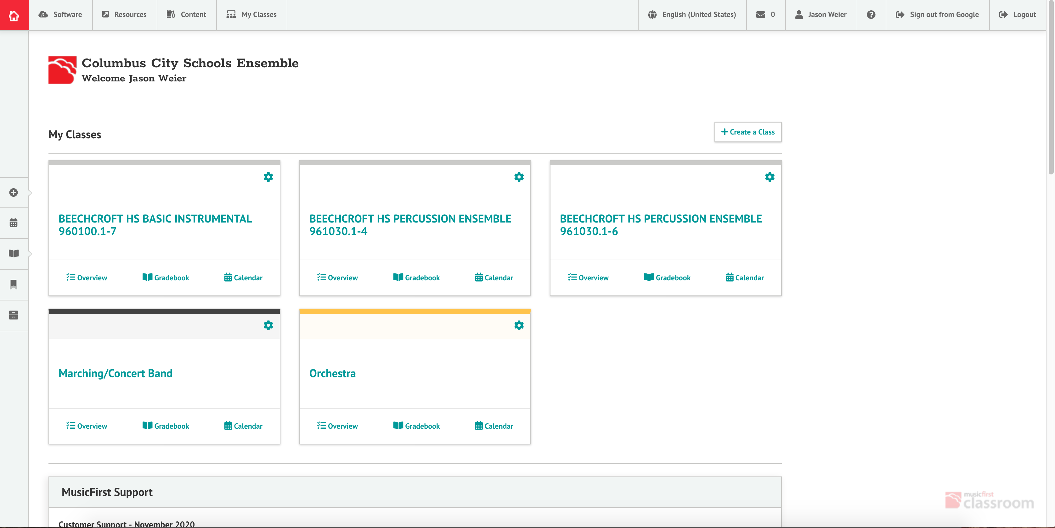
Landing Page

Slide 4
On the landing page, you will see all of your classes listed. You can access your gradebook for each class, or check the calendar.
If students have submitted assignments, you will see a notification sign (Bell) in the box for that class.
If you click on a class, it will take you to that class’s landing page.

Slide 5
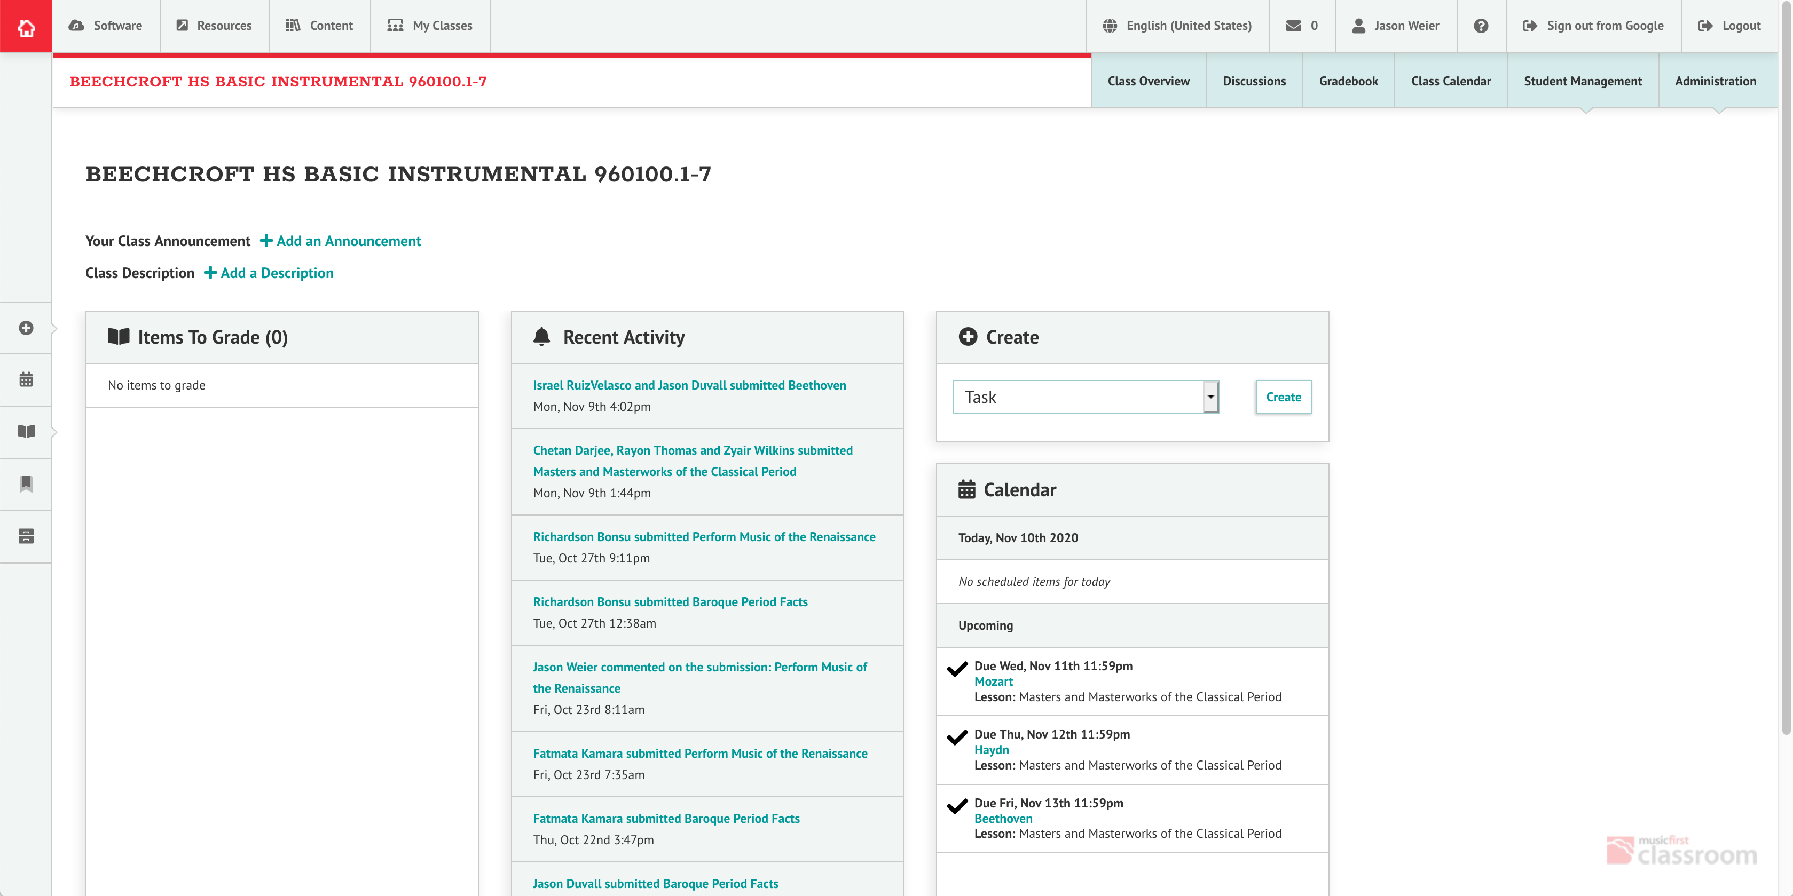
On this page, you will see a listing of items to grade, upcoming due dates, and recent activity (comments, or submissions)

Slide 6
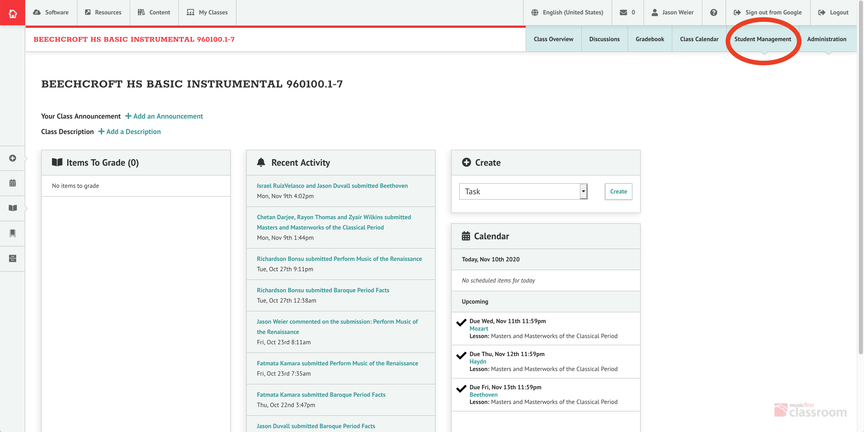
To add, edit, or remove students from your classes, click on the student management tab in the upper right corner.
Note* This is also useful because it will show you if/when students have logged in.

Slide 7
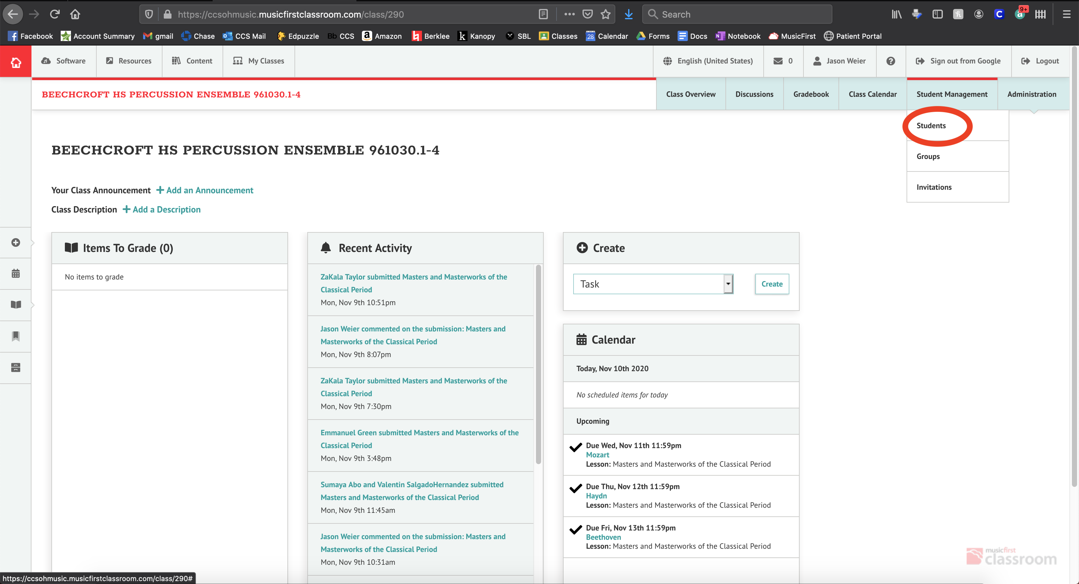
Under the drop down menu, select Students:

Slide 8
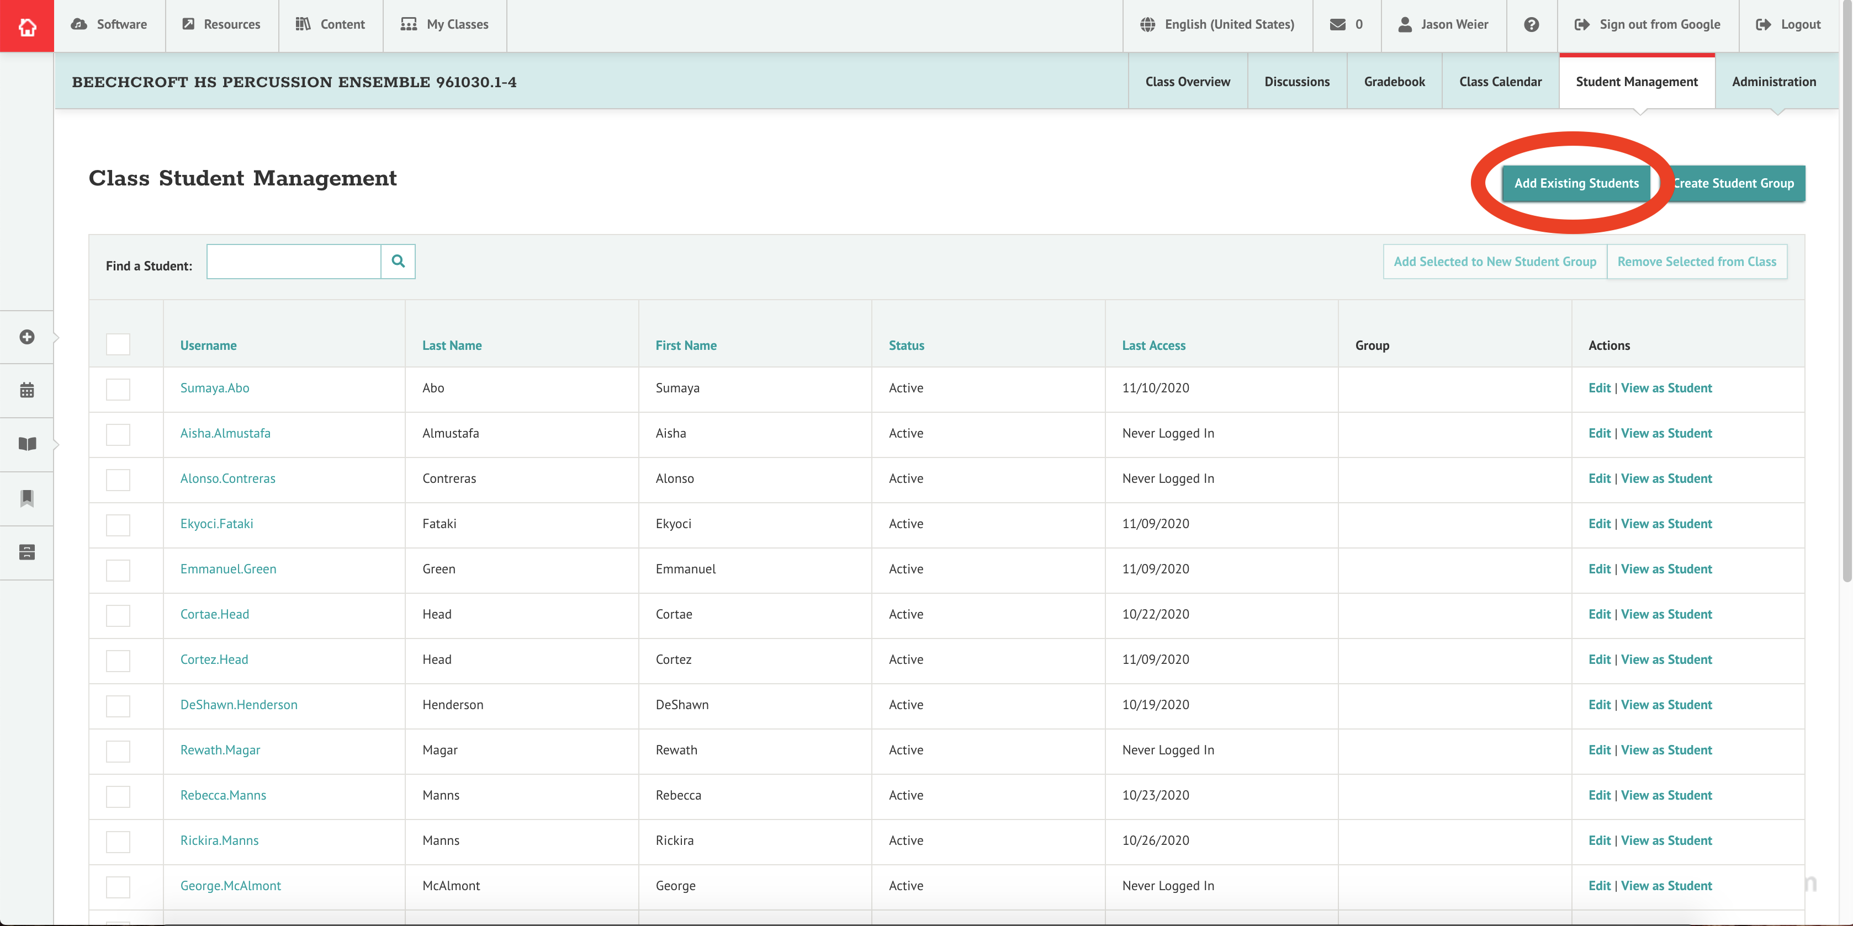
In order to add a student to your class, you will need to select Add Existing Students:

Slide 9
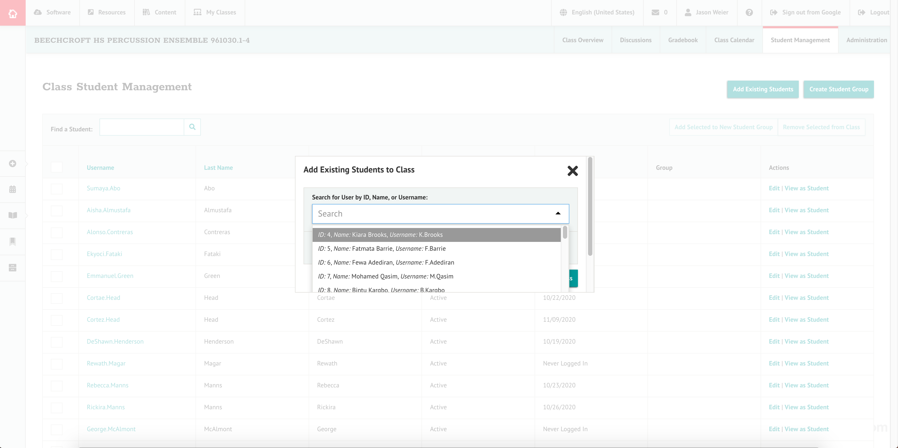
Once you have selected Add Existing Student, you will see a drop down menu with a search bar. Here, you can type a student’s name, or select from the list. All students in the district have been uploaded by Dr. Hill. (check for typos and name misspellings)

Slide 10
Logging students in

Slide 11
Now you can let your students know how to log in.
Students will go to ccsohmusic.musicfirstclassroom.com
Student username is First.Last (Joe.Brown) if they have two last names it is First.LastLast (John.JonesBrown)
Student Password is their Student ID number (tip: You can log in as a student to make sure everything is working correctly on their end. *This is especially helpful when students claim that they can’t log in)

Slide 12
Assigning Tasks

Slide 13
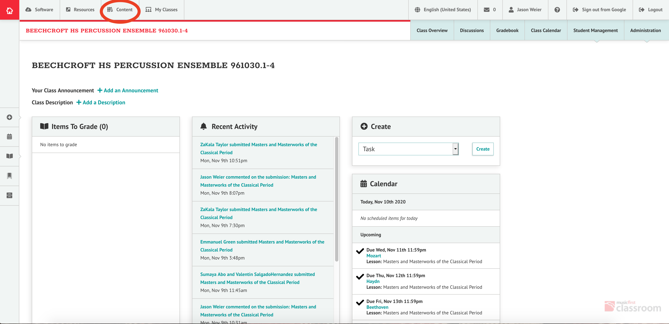
Step 1: choose an assignment by either creating one in the create tab, or by searching the content library. Let’s use the Content Library.

Slide 14
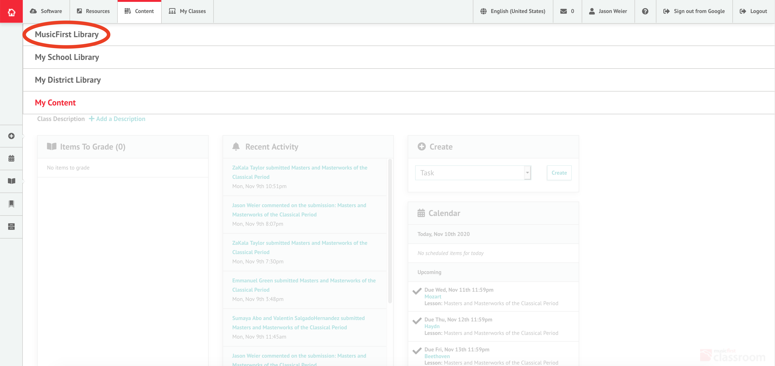
Under the Content tab, you will click on MusicFirst Library. Here you will find a wealth of lessons, units, and assessment for Band, Orchestra, Choir, or General Music.

Slide 15
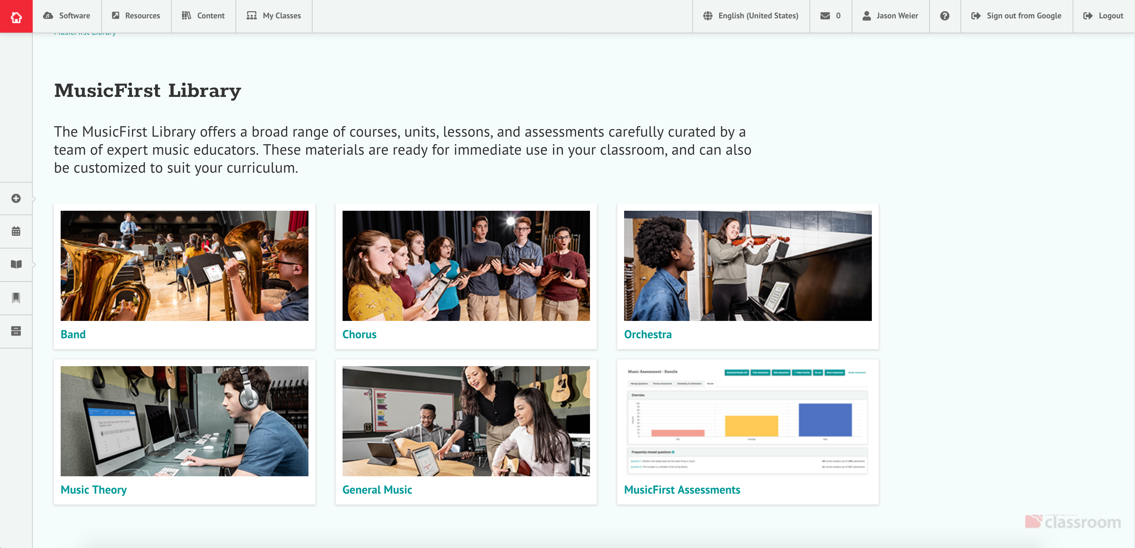
Once you are in the MusicFirst Library, select the class type of your choice:

Slide 16
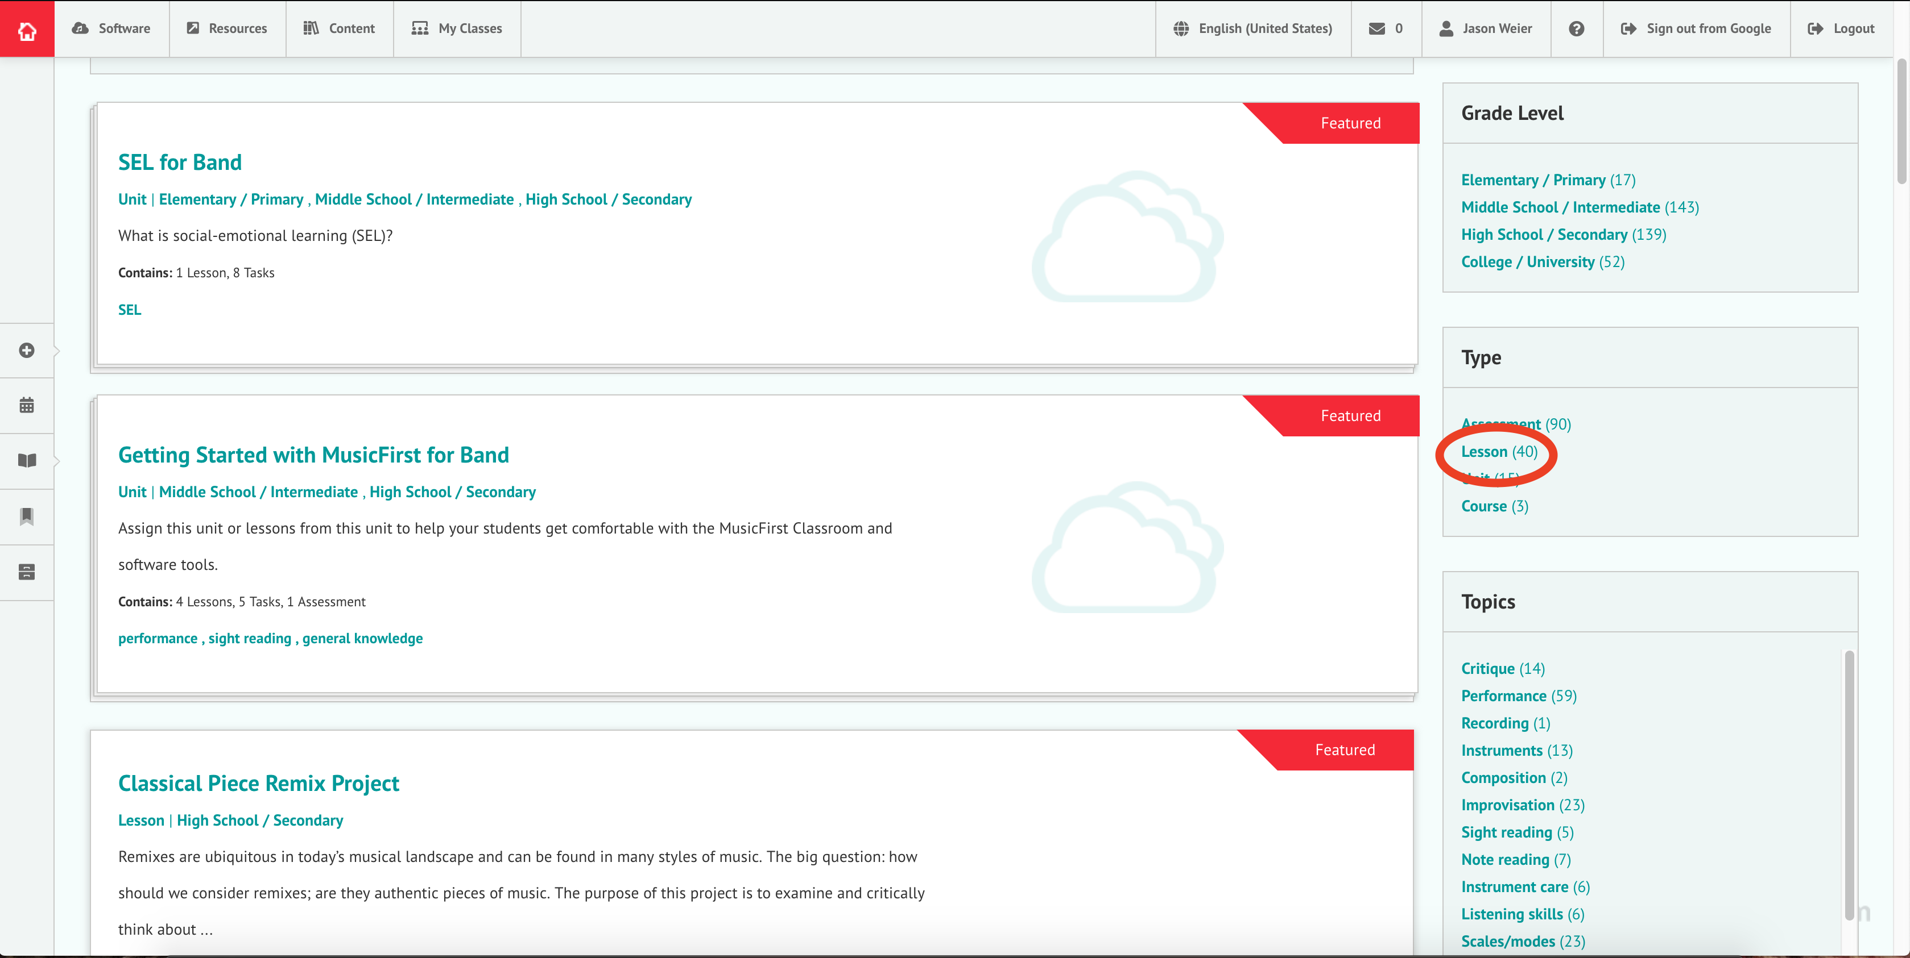
From here, you can search for assignment type, let’s choose Lesson for now.

Slide 17
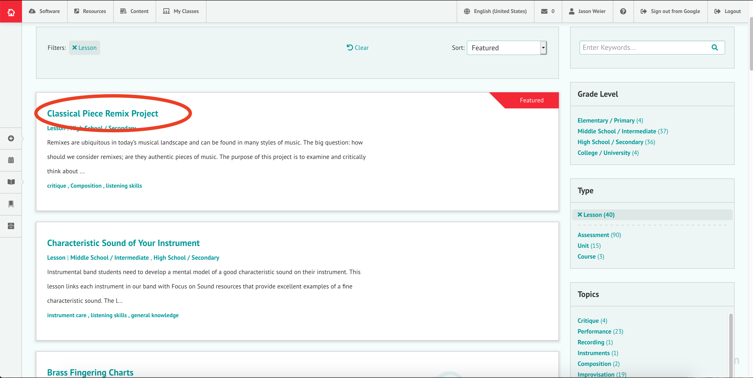
Now, select a lesson from the list:

Slide 18
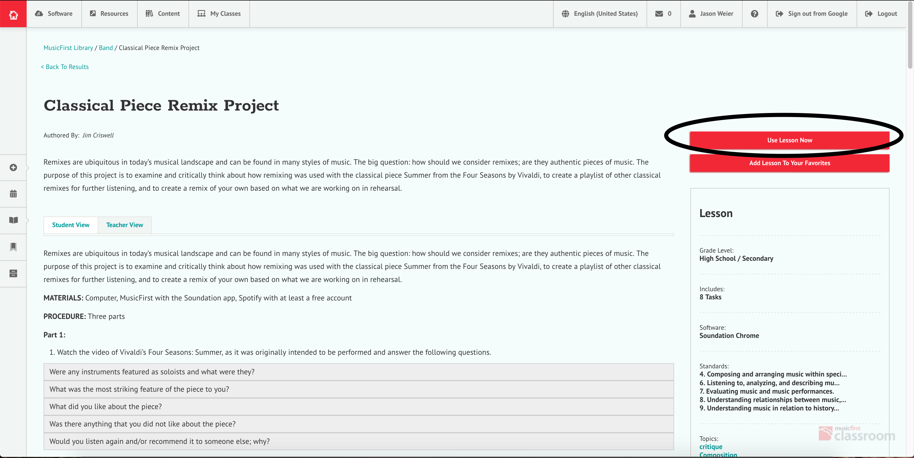
Once you choose a lesson, if you want to assign it, you will need to click on “Use Lesson Now”

Slide 19
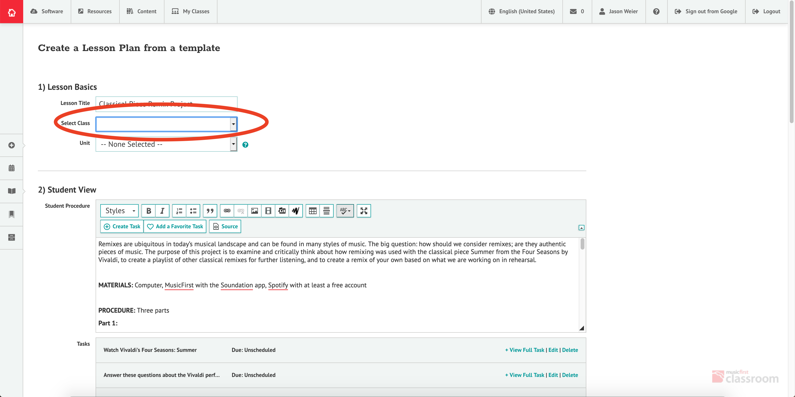
Next, you’ll decide which class you want to use the lesson in.

Slide 20
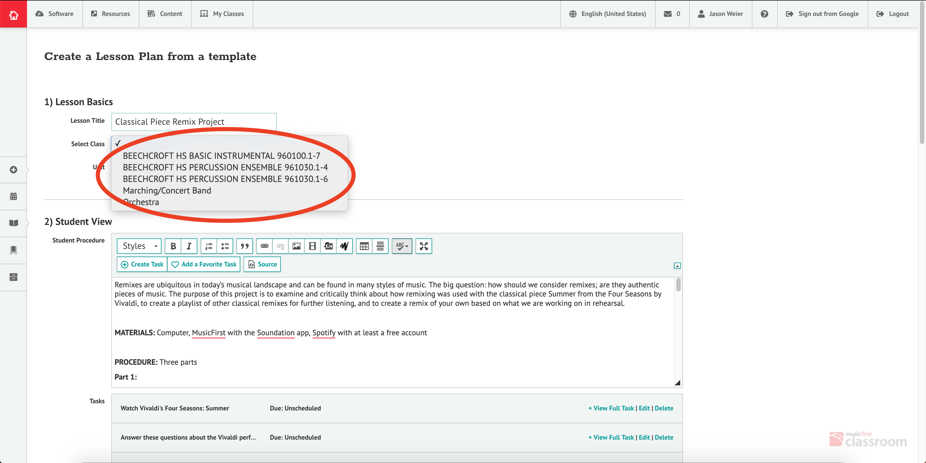
There will be a drop-down menu of your classes to assign to.

Slide 21
Scheduling Assignments

Slide 22
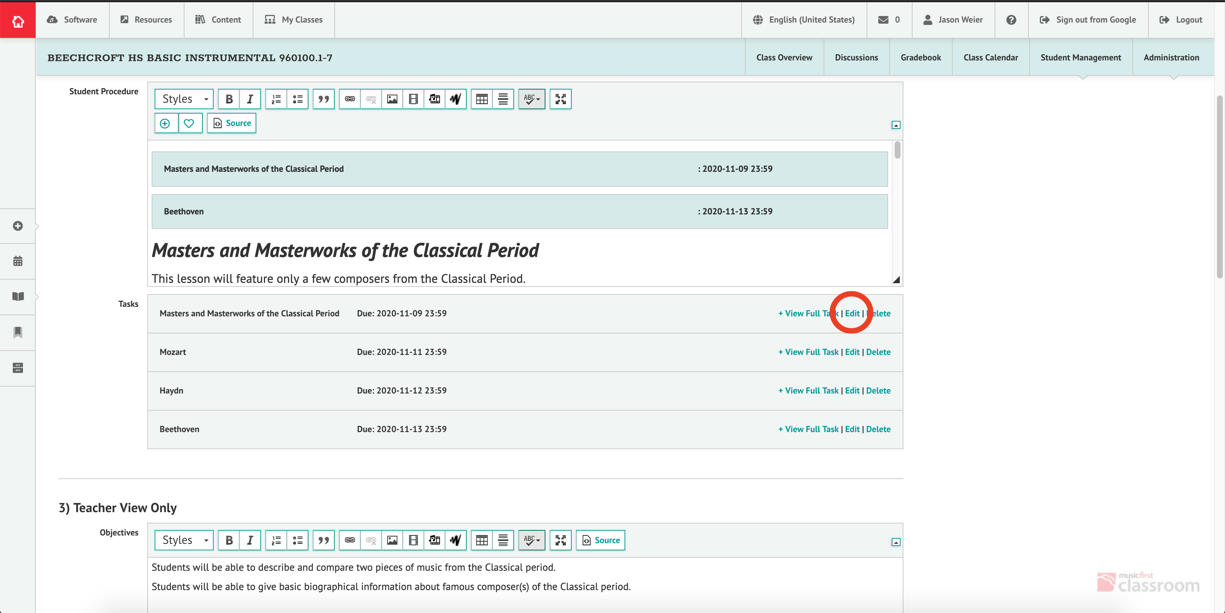
In order for assignments to be visible to students, you’ll need to edit the lesson and tasks with due dates and grade criteria. Click on the edit tab for a task to get started.

Slide 23
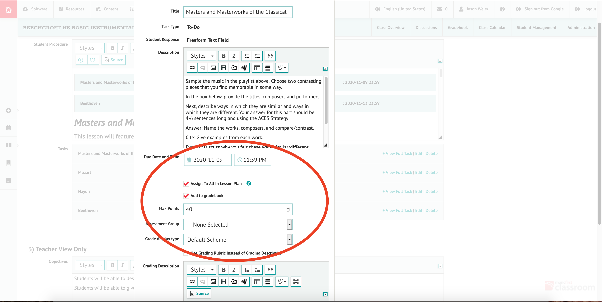
Next, you will choose a due date and a points value. Make sure to check the box for “add to gradebook”

Slide 24
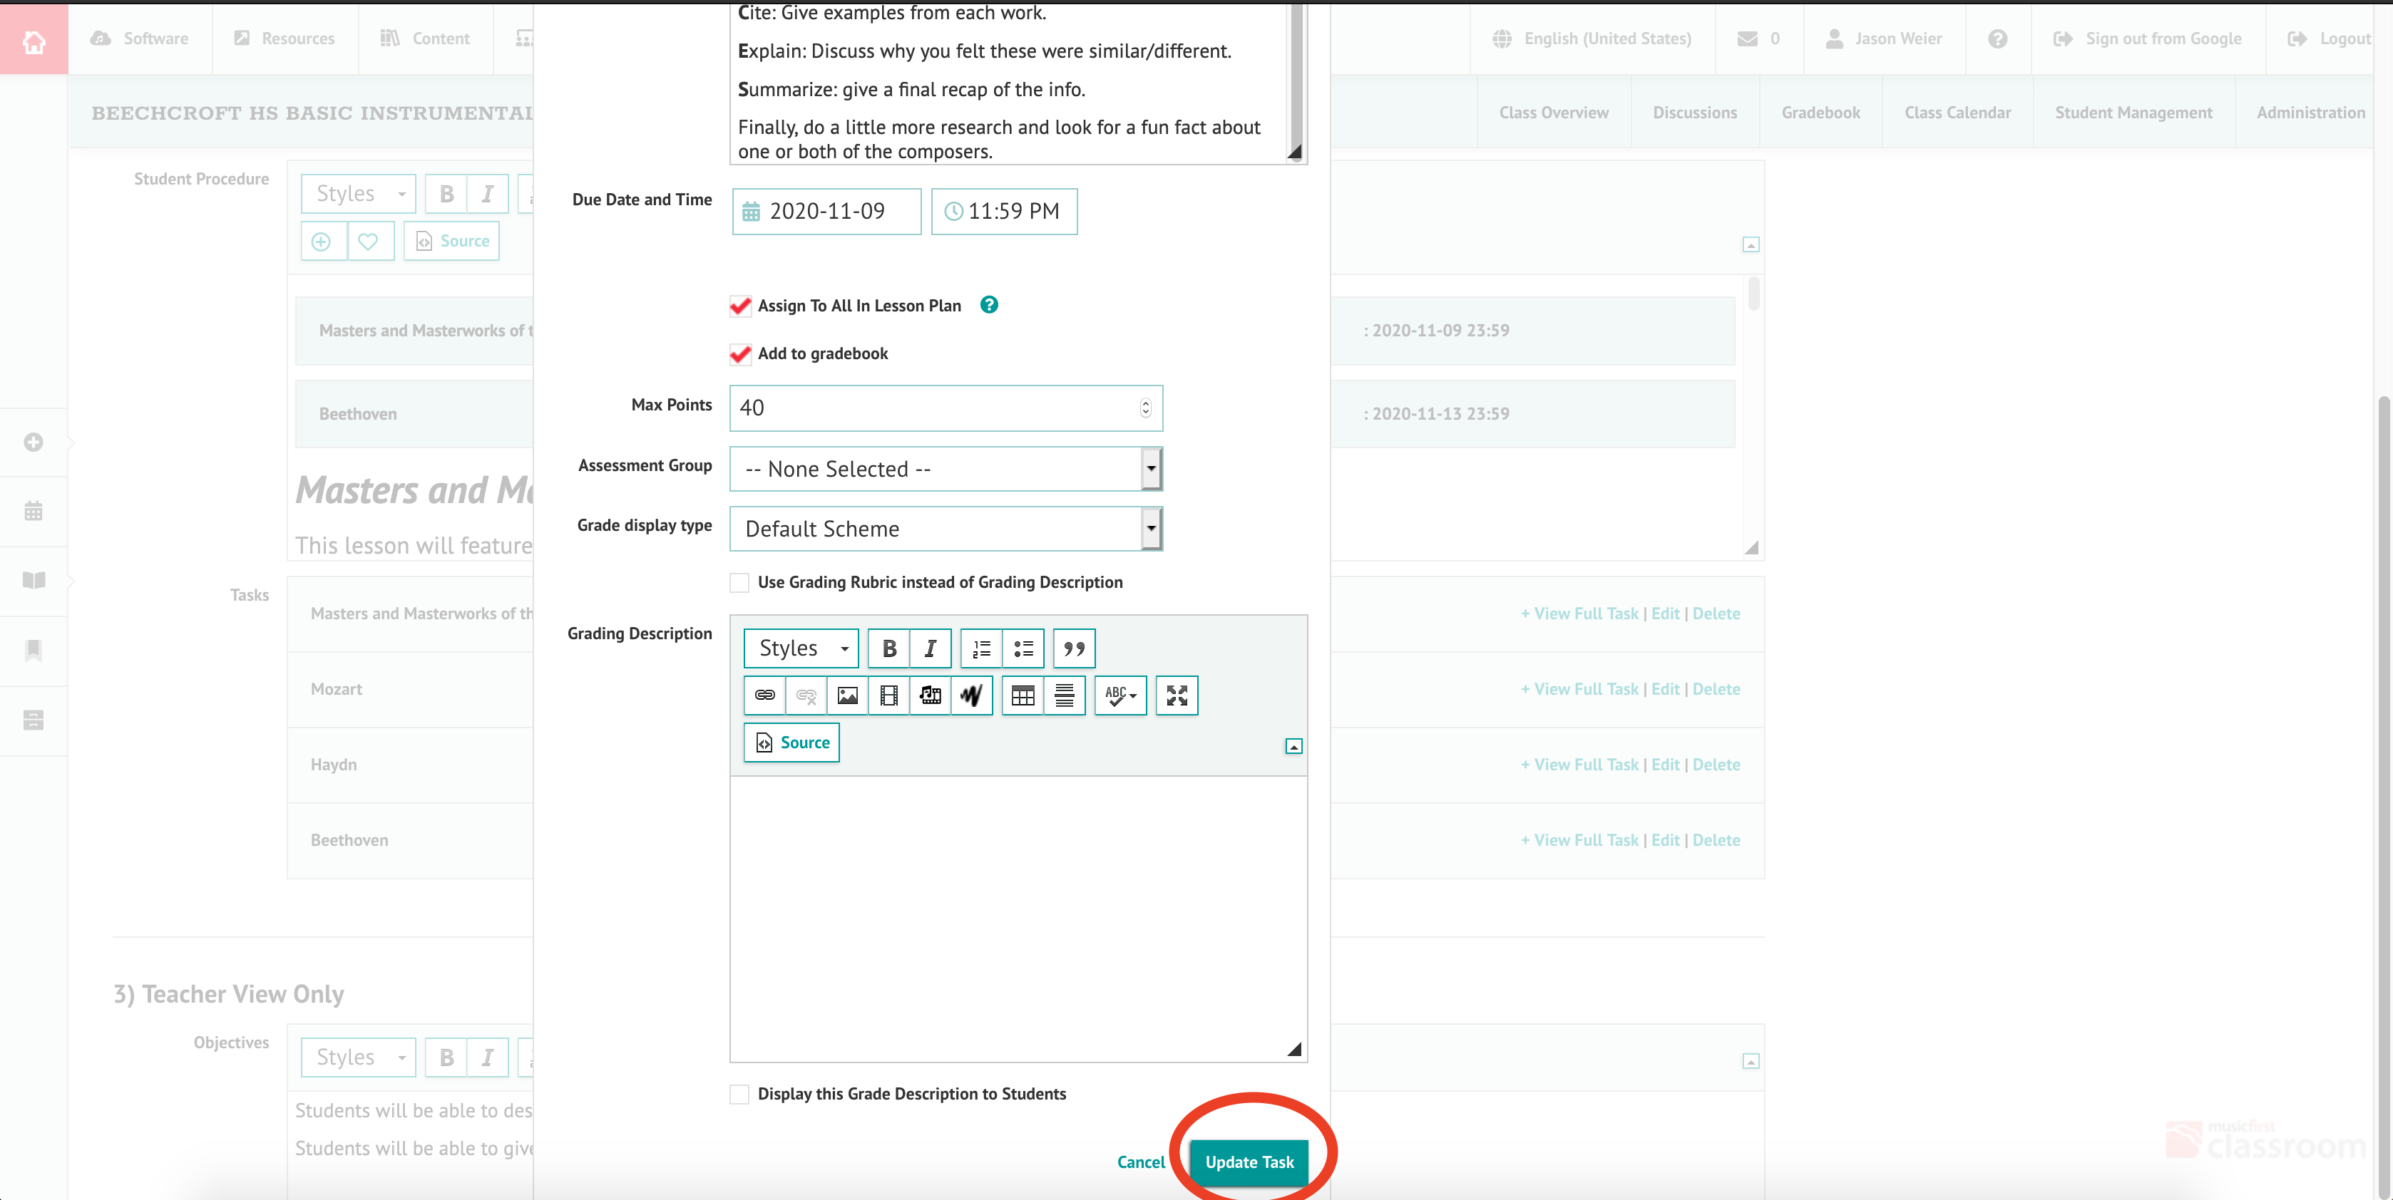
Now, choose “Update Task” Do this for each task within the lesson.

Slide 25
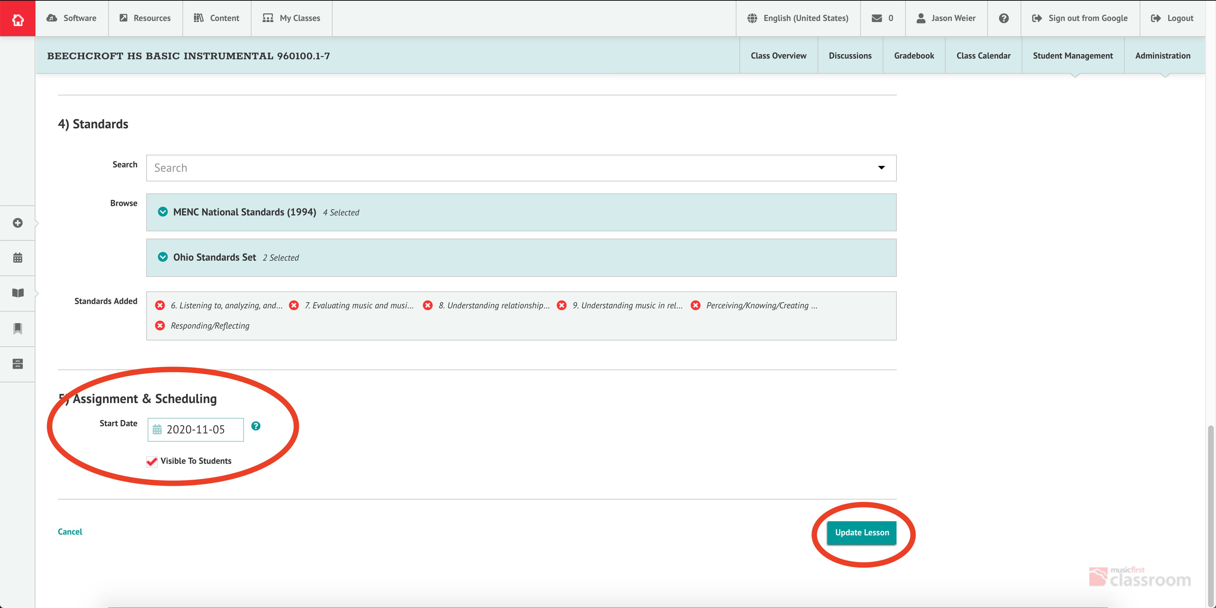
Finally, scroll down to the bottom of the screen. Choose a start date for you lesson, check the box for “Visible to Students”, and click “Update Lesson”. Here You can also add State and National Standards to your lesson as well.

Slide 26
Sharing to Google Classroom

Slide 27
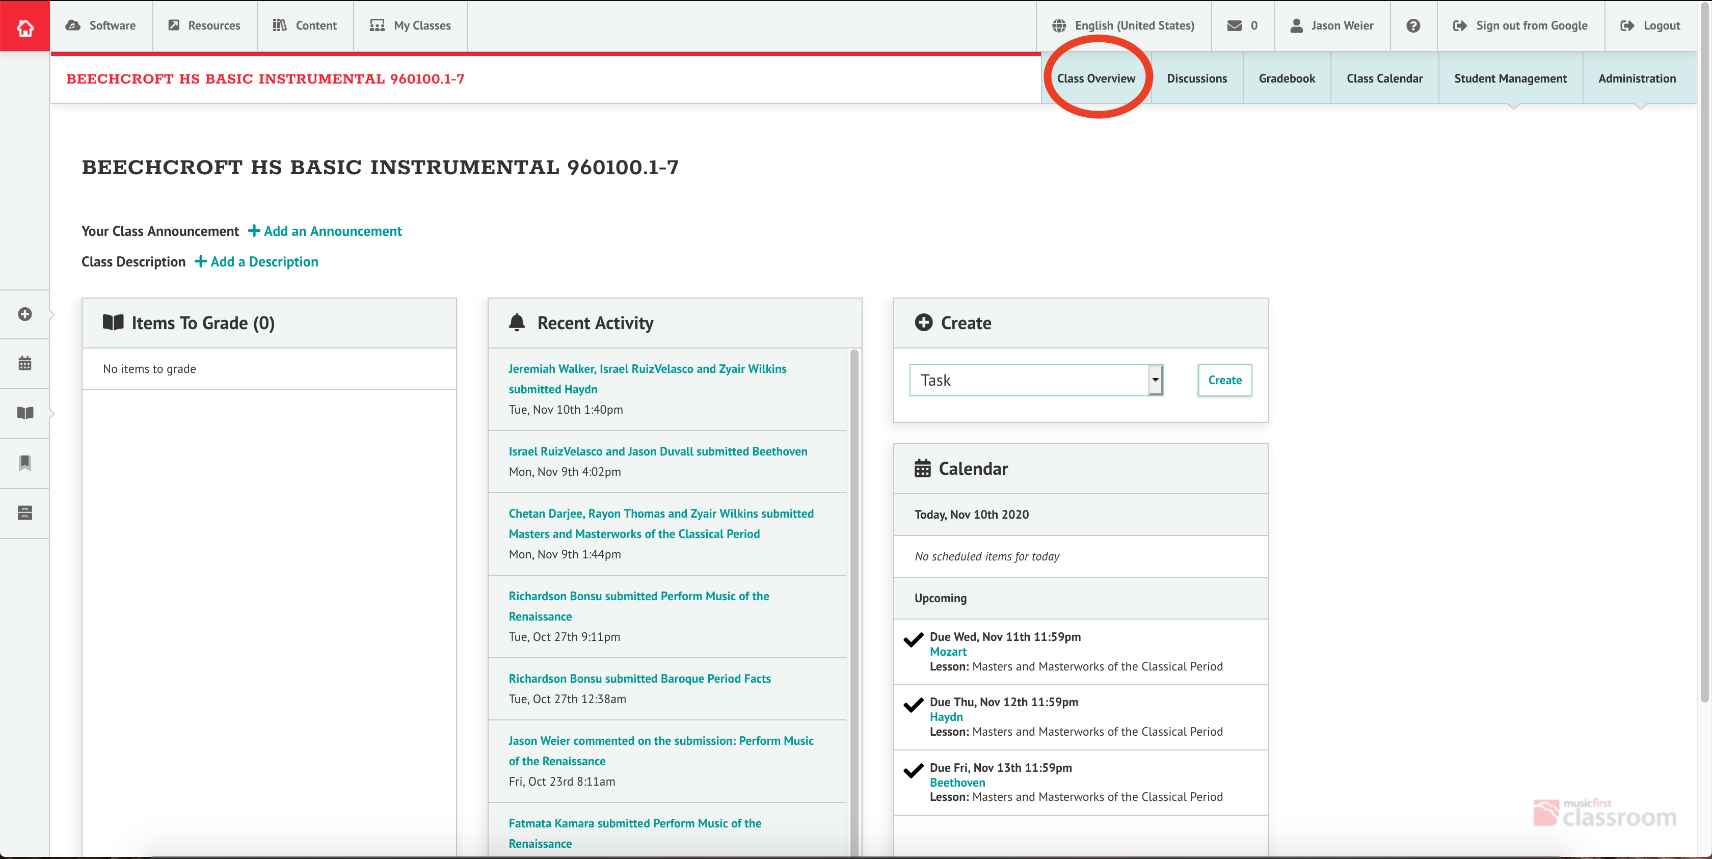
Step one is to open a class page, and click on the Class Overview tab.

Slide 28
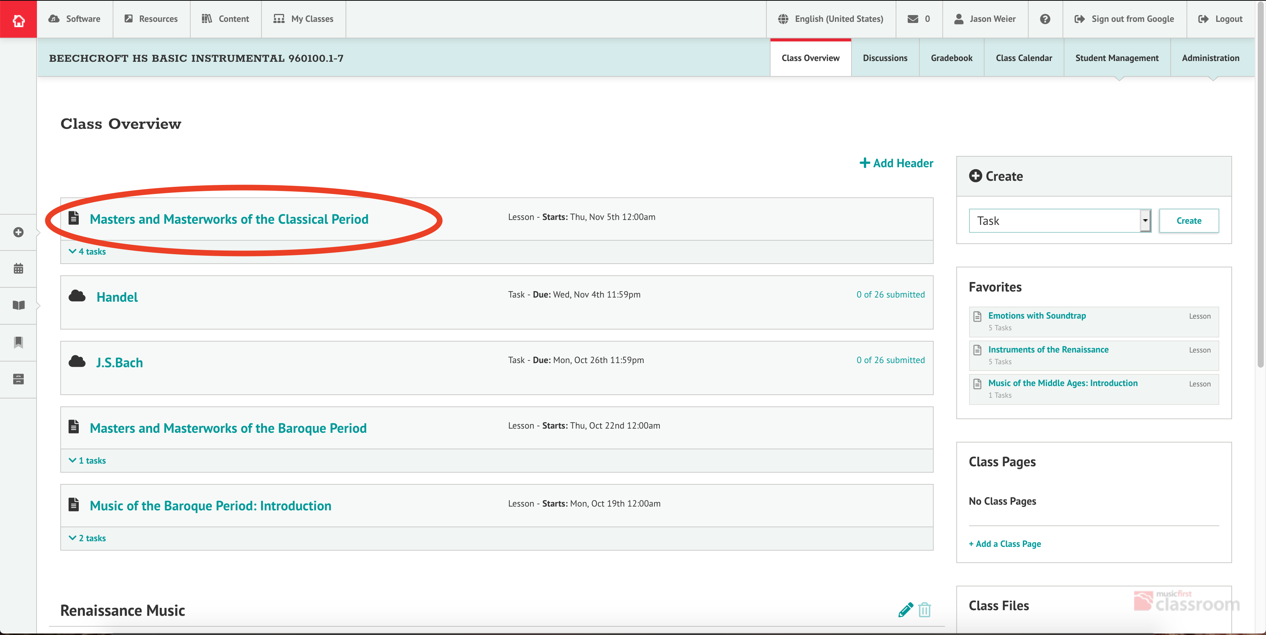
From there, choose a lesson you want to share to Google Classroom.

Slide 29
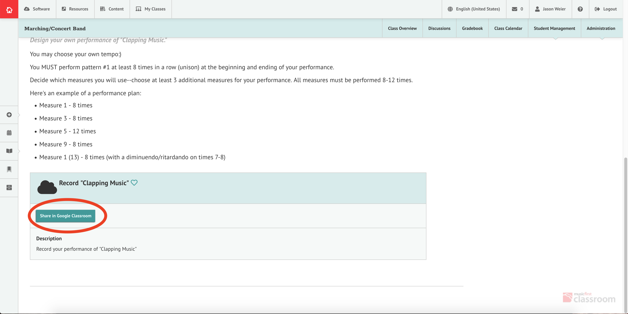
Only graded items can be shared to google classroom. These are referred to as “Tasks” As you scroll through the lesson, you will see a box marked “Share in Google Classroom”

Slide 30
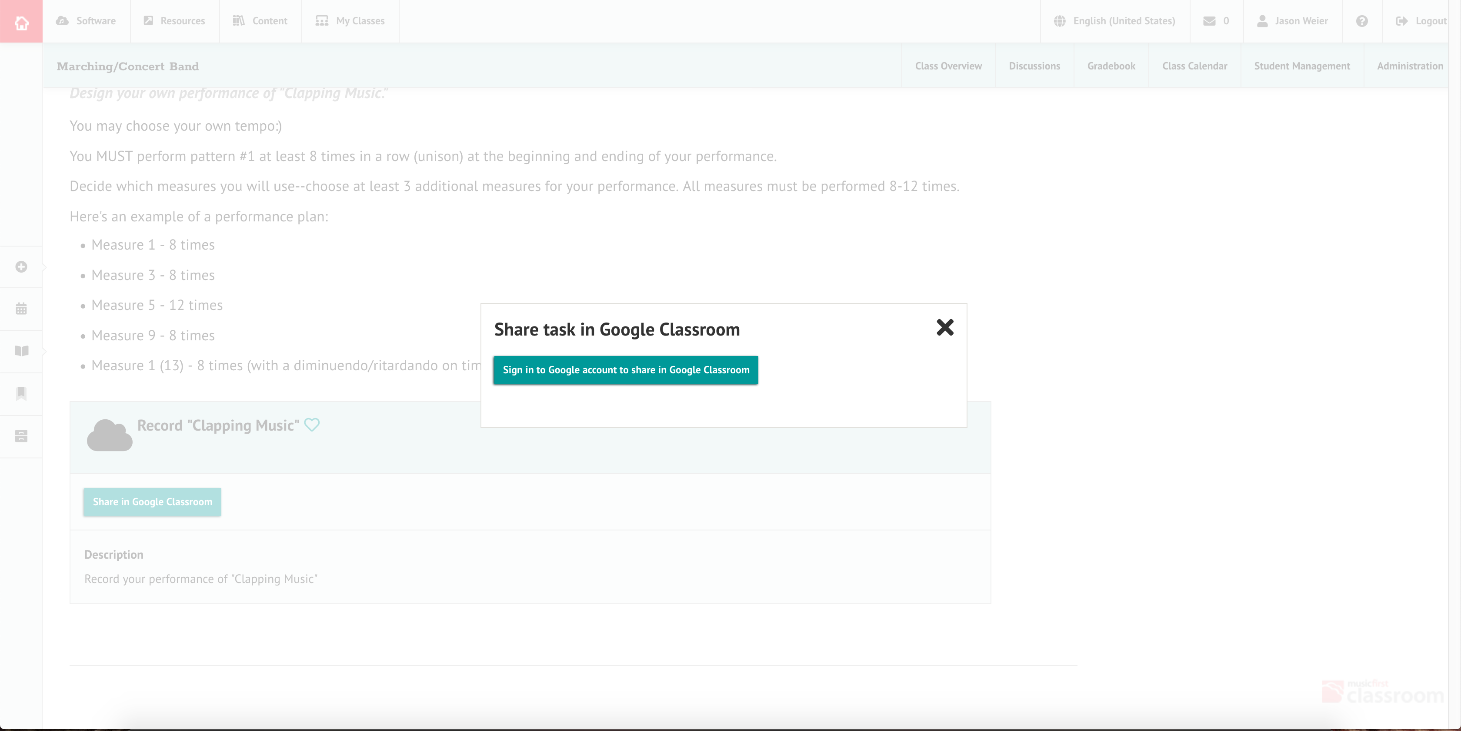
The first time you do this, you will need to sign in with your ccs email address to link with Google Classroom

Slide 31
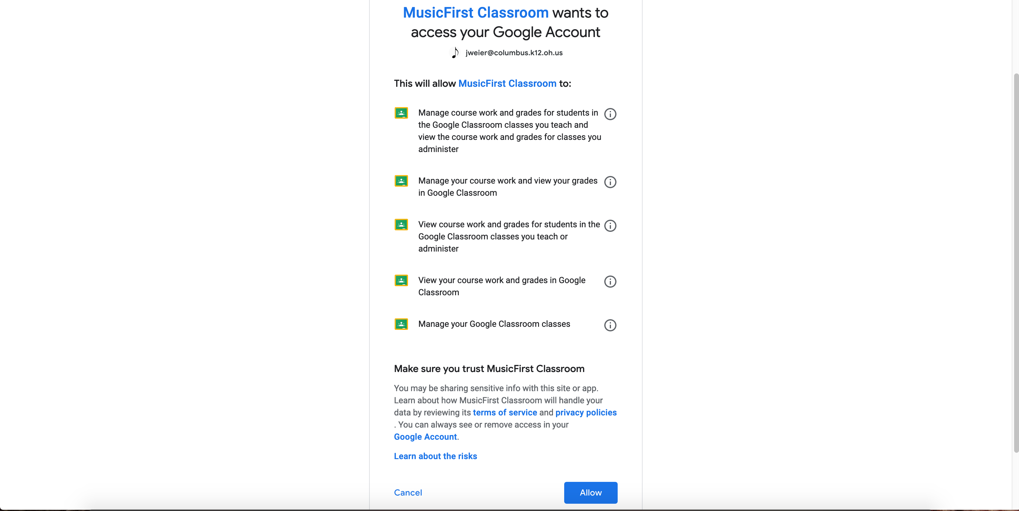
You’ll then need to allow MusicFirst to access Google Classroom information.

Slide 32
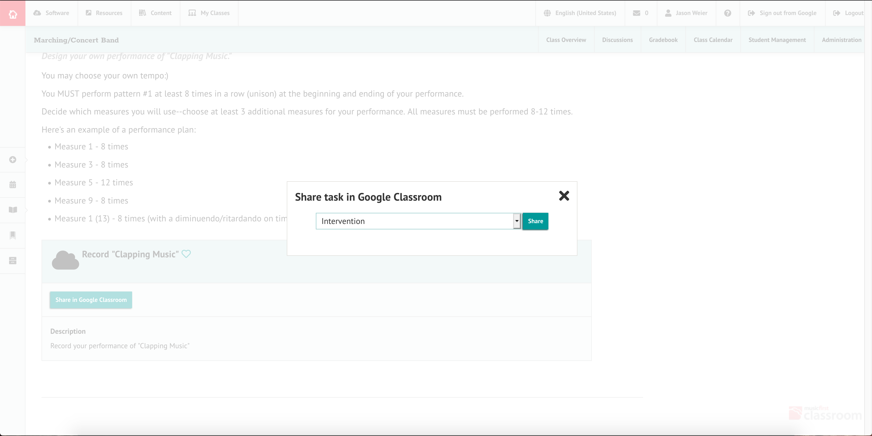
Once you’ve done that, you will get a drop down menu of your classes. Repeat the process for all tasks you want to share.

Slide 33
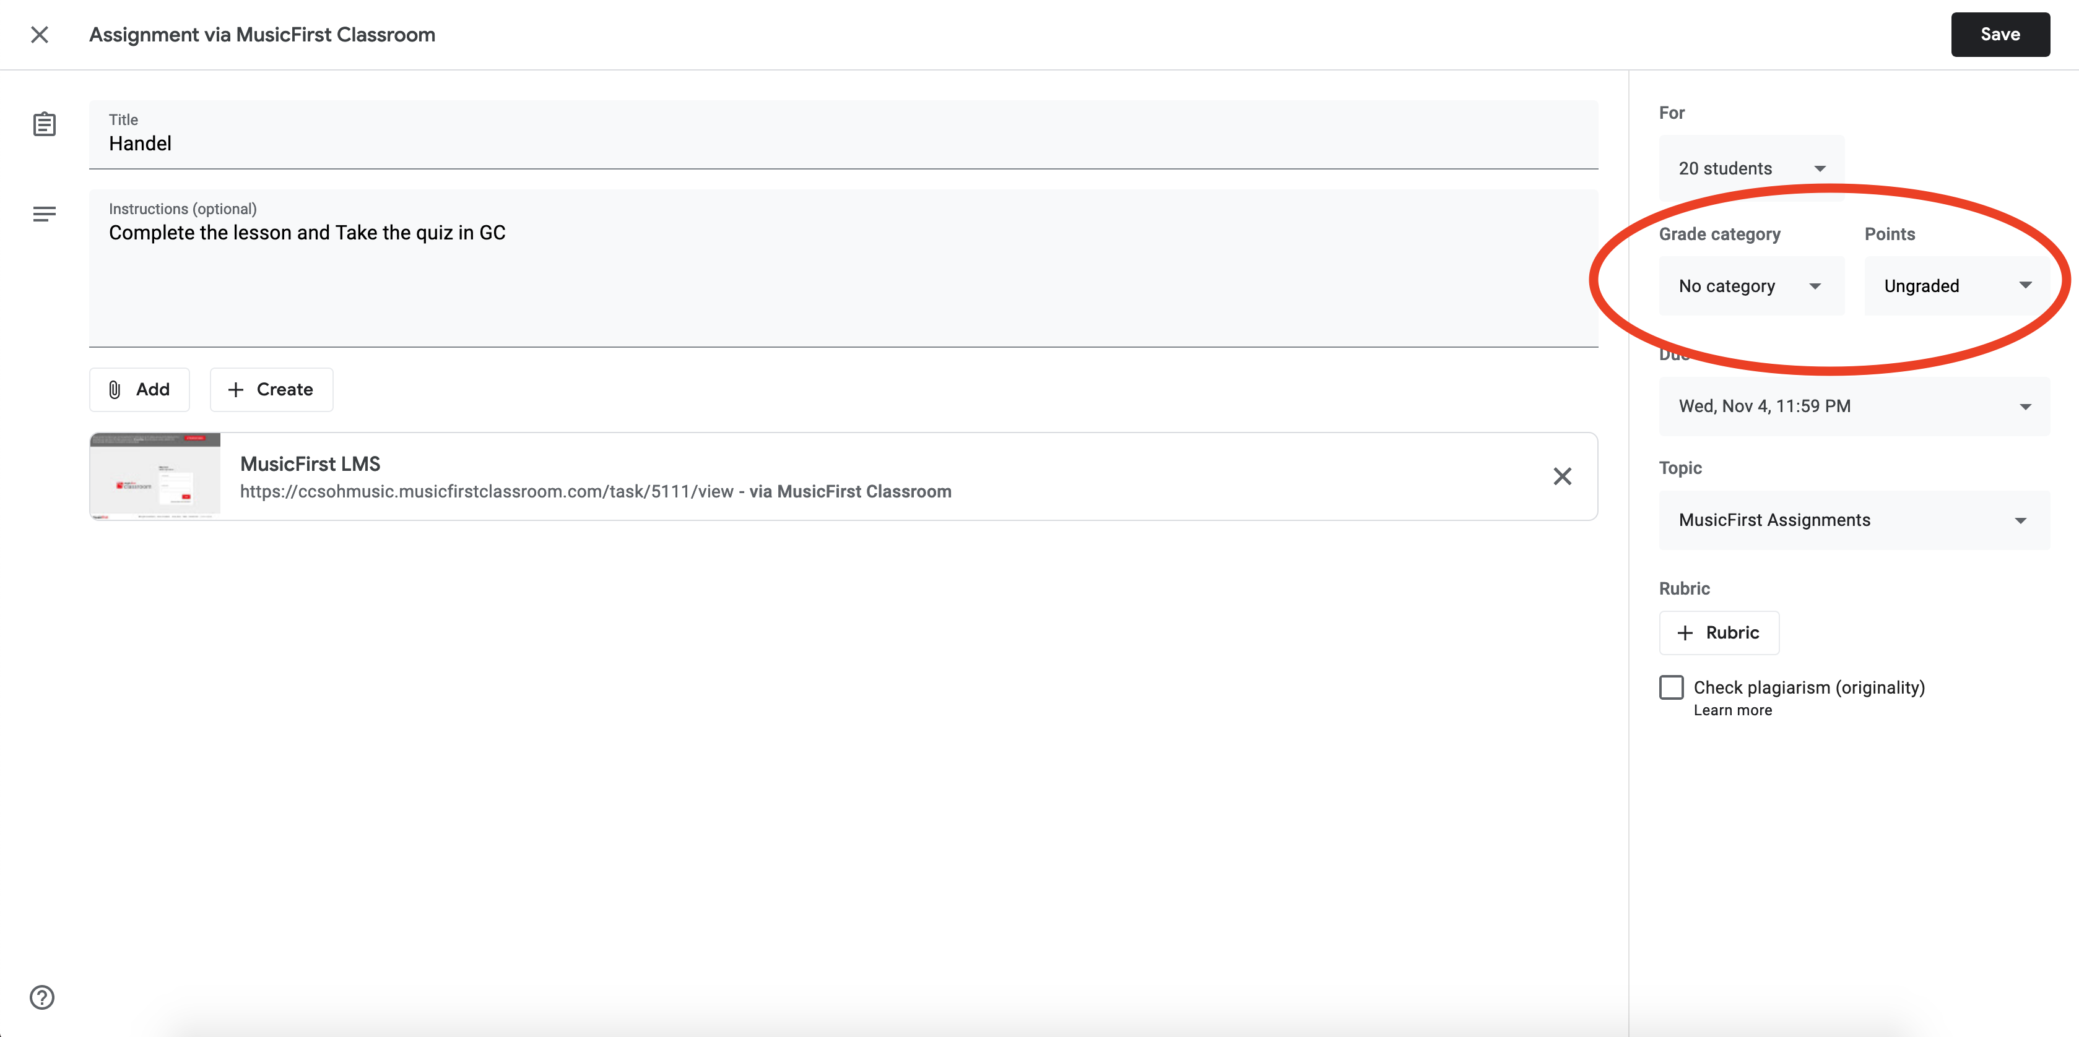
Important: MusicFirst does not transfer assignment categories or point values for assignments. Once you have shared to Google Classroom, you will need to go into Google classroom and edit that assignment with categories and points available.

Slide 34
Feel free to contact me with any further questions
Jason Weier: jweier@columbus.k12.oh.us

