Slide 1

Classified Performance
Evaluation Overview
Presented By
Human Resources Administration

Slide 2
Purpose
Review the CCS process for conducting Classified evaluations

Slide 3
Managing Human Performance Is:
Encouraging and helping others to perform their tasks competently
Coaching others to live up to their potential
Supporting the development of others’ skills
Closely observing performance and providing appropriate consequences to correct or reward behavior
Notes:
Review

Slide 4
Performance Evaluation Use
To serve as an instrument for performance enhancement
To serve as an instrument for direction
Not as a disciplinary instrument
Notes:
Review

Slide 5

Supervisor Responsibilities
Keep good records
Communicate - Rater, Employee, Reviewer
Make fair and honest decisions
Provide feedback
Provide coaching when needed
Submit evaluations on time with appropriate signatures
Notes:
Review

Slide 6
Types of Performance Evaluations
Probationary
  Mid probationary
  Final probationary (30 days prior to end)
Annual
Notes:
Review

Slide 7
Raters and Reviewers
Raters - employee’s immediate supervisor
Reviewer - department head
Notes:
Review

Slide 8
Reviewers Responsibilities
Reviewer can inspect ratings for consistency and adds comments before the rater completes the evaluation
Reviewer will not be able to add comments once the evaluation is sent by the Rater to Human Resources
Notes:
Review

Slide 9
Rater and Reviewer Meeting
If needed (not a requirement):
Discuss Ratings
Clarify Discrepancies
Notes:
Review

Slide 10
Notification of Evaluation
Conference
At least 3 days prior to the conference
Rater distributes to the employee (helpful, but not required)
  previous performance evaluation
  job specification
The Rater should review the same
Notes:
Review

Slide 11
The Evaluation Conference
Rater prints and signs the form
Rater meets with employee
Discuss ratings and obtains:
  employee’s signature (If employee refuses to sign, write that on the form and include your initials)
  employee’s comments
Notes:
Review

Slide 12
Classified Technical Training
Please refer to the Classified Personnel Evaluation Guide

Slide 13
One Evaluation for All
Classifications with Common Competencies
1. Attendance
2. Dependability
3. Service to Customers
4. Relations with Fellow Employees/Students
5. Flexibility and Adaptability to Change
6. Knowledge of the Job/ Technical/Aptitude
7. Leadership and Management of Skills
8. Quality and Quantity of Work
9. Resource Management

Slide 14
Completion of the Evaluation Form
Rater marks level of performance
Ratings
  Exceeds Expectations (Comments Required)
  Meets Expectations
  Improvement Needed (Comments Required)
  Does Not Meet Expectations (Comments Required)
Notes:
Review

Slide 15
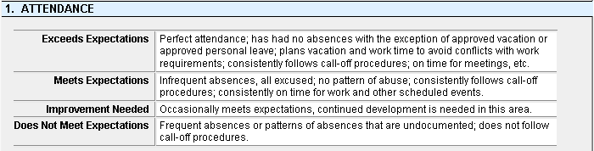
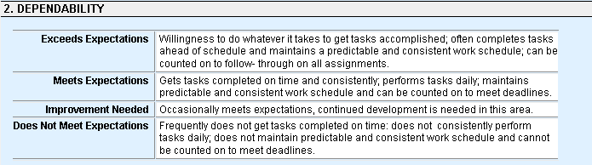
Evaluation Competencies and Ratings

Slide 16
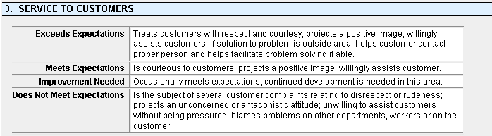
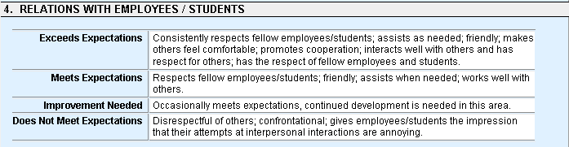
Evaluation Competencies and Ratings

Slide 17
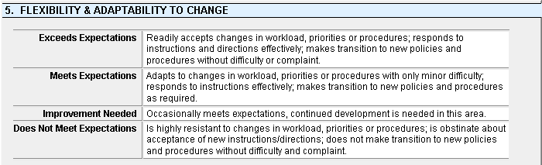
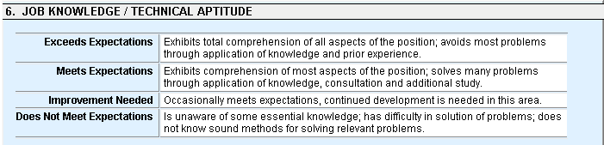
Evaluation Competencies and Ratings

Slide 18
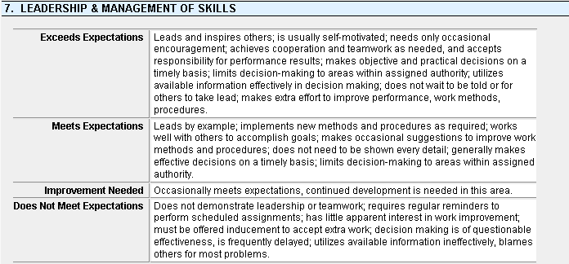
Evaluation Competencies and Ratings

Slide 19
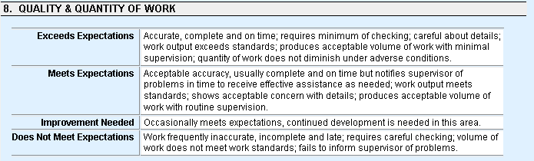
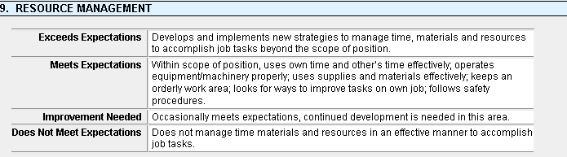
Evaluation Competencies and Ratings

Slide 20
Distribution of the Completed Evaluation
Keep a signed copy of the evaluation for your records
Provide a signed copy to the employee (Can give a copy to the employee even if the employee refuses to sign)
Send the signed evaluation to Human Resources (Include ALL pages) @ Hrevaluations@columbus.k12.oh.us
Notes:
Review

Slide 21

Items of Consideration
Contact Mary Anne Baum – Manager, Labor Management & Employee Relations for all “Does Not Meet Expectations Summative” evaluations to assist with completing an Individual Development Plan by April 5, 2024. Click here for the form.
School based evaluations due by May 17, 2024
Non-school based evaluations due by June 19, 2024
Bus Drivers & Food Service evaluations due by September 30, 2024
Notes:
Review

Slide 22
Challenge Process
Applicable only if receives “Does Not Meet Expectations” on Summative Evaluation Rating
Use official challenge form: Classified Evaluation Employee Challenge Form
EMPLOYEE MUST SUBMIT FORM TO Human Resources Administration within 3 work days of employee viewing signed evaluation
Notes:
Review

Slide 23

The Challenge Conference Participants
Director of Human Resources Administration conducts conference
Employee, Rater and/or Reviewer, and a union representative if requested by employee
Notes:
Review

Slide 24
The Challenge Decision
Director of Human Resources Administration’s decision is final and binding
Notes:
Review

Slide 25
Notes:
Review

